Slide 1
STOCK ANALYSIS
Seemab Haider, Shreya Akotiya, Mia Shi, James Qui, Anjali Skilton

Slide 2
PROJECT REASONING
Curiosity into correlation between stocks and crypto
Curiosity into the correlation of different stock market sectors

Slide 3
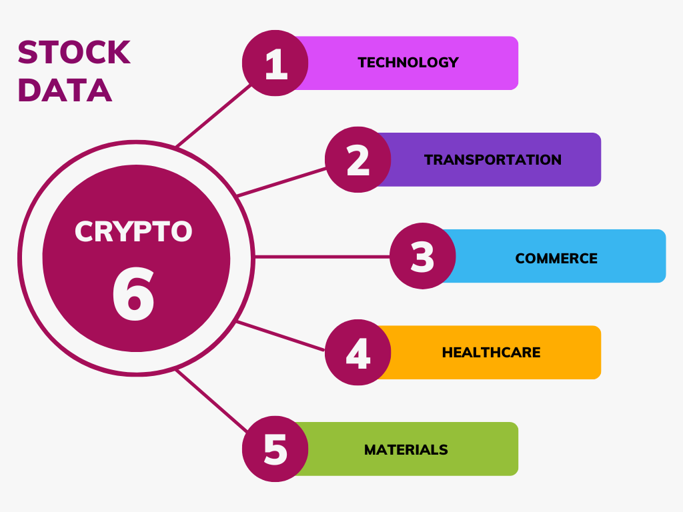
DESCRIPTION
OF
DATA

Slide 4

WHAT WE USED

Slide 5
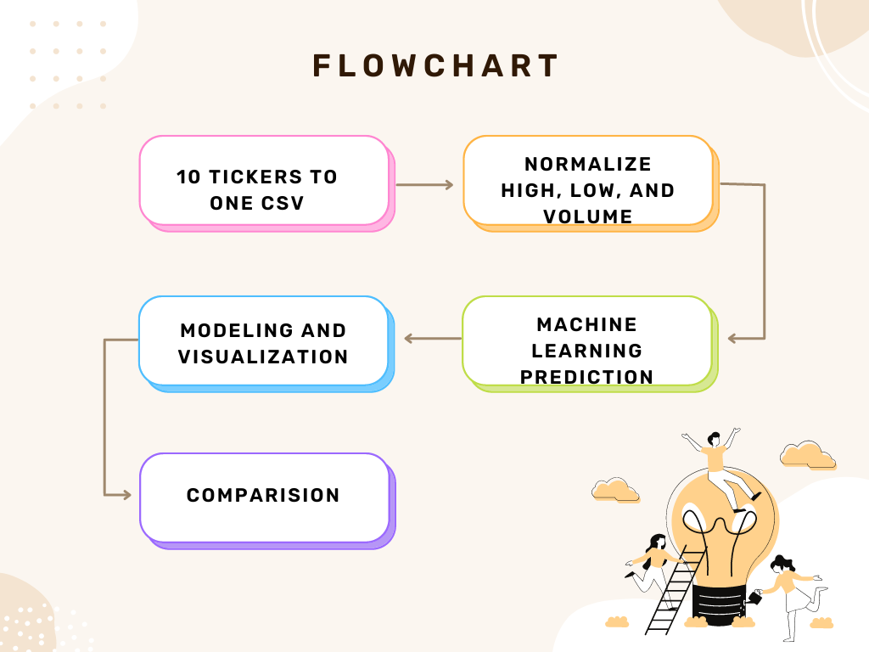
DATA PROCESSING

Slide 6
QUESTIONS THAT WILL BE ANSWERED
What is the correlation between stock sectors?
What is the correlation between stock sectors and Bitcoin?
How multiple indices show correlations between sectors and Bitcoin?

Slide 7
6 SECTORS
DESCRIPTION OF DATA
51 UNIQUE STOCKS
ANALYZED HIGH & LOW PRICES, AND VOLUME
ANALYZED BY PYTHON, SQL, AND TABLEAU
USED LINEAR REGRESSIONS MACHINE LEARNING MODEL

Slide 8
RESULTS

Slide 9
THANK YOU!

Slide 12
Consumer Cyclicals

Slide 13
Ticker | Name | Price (Intraday) | Avg Vol (3 month) | Market Cap (Billion) | PE Ratio (TTM)
AZO | AutoZone, Inc. | 2326.61 | 145529.00 | 43.66 | 19.57
BKNG | Booking Holdings Inc. | 2401.58 | 341614.00 | 93.16 | 39.56
CMG | Chipotle Mexican Grill, Inc. | 1555.19 | 295773.00 | 43.11 | 52.42
HMC | Honda Motor Co., Ltd. | 23.95 | 1124000.00 | 40.52 | 8.01
LULU | Lululemon Athletica Inc. | 312.80 | 1828000.00 | 39.89 | 34.99
LVS | Las Vegas Sands Corp. | 54.57 | 5677000.00 | 41.70 | 22.57
MAR | Marriott International, Inc. | 166.91 | 1957000.00 | 52.83 | 25.48
ORLY | O'Reilly Automotive, Inc. | 793.38 | 455070.00 | 49.65 | 24.25
ROST | Ross Stores, Inc. | 115.73 | 2642000.00 | 39.85 | 28.02
YUM | Yum! Brands, Inc. | 126.63 | 1799000.00 | 35.67 | 28.85

